Slide 1
Superintendent’s
FY24 School Operating Budget Request
Public Hearing Presentation
January 17, 2023
Portrait of a Needham Graduate

Slide 2
The challenging context for developing a budget request to support the
Needham Public Schools in 2023-24 (FY24)
• COVID Students’ safety & wellness, learning, emotional, and mental health needs continue to dominate planning and programming in the aftermath of the COVID pandemic
• Enrollment School enrollment is down from 2019-20 but continues to grow back to pre-pandemic levels; an additional 68 students projected next year; Building capacity for Preschool & special education essential
• Inflation The State has unilaterally imposed a significant tuition increase for students enrolled in special education private schools; district supply costs up

Slide 3
The challenging context for developing a budget request to support the
Needham Public Schools in 2023-24 (FY24)
• Wages Staff salaries will increase significantly in order to maintain services and provide reasonable, fair and competitive wages
• Staffing The challenge to hire qualified and diverse staff to support student learning and provide services remains due to labor shortages
• Infrastructure School building maintenance needs and school transportation require significant and ongoing attention, funding, and management; inflation & supply chain issues persist

Slide 4
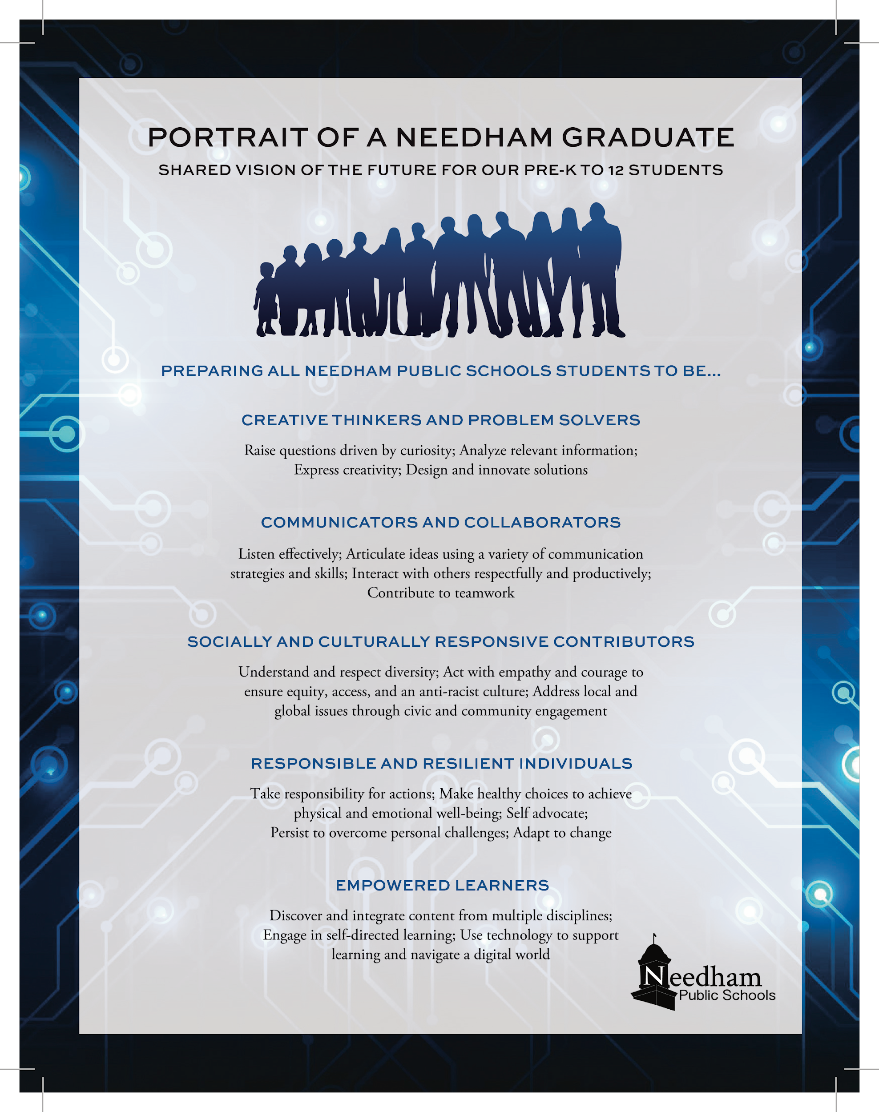
Portrait of a Needham Graduate Strategic Priorities 2020-2025
PRIORITY #1
ALL STUDENTS ARE DRIVERS
OF THEIR OWN
LEARNING
PRIORITY #2
ALL STUDENTS EXPERIENCE INTEGRATIVE TEACHING AND LEARNING
PRIORITY #3
ALL STUDENTS LEARN & GROW
WITHIN ADAPTABLE ENVIRONMENTS
PRIORITY #4 INFRASTRUCTURE SUPPORTS
NEEDS OF
ALL STUDENTS

Slide 5
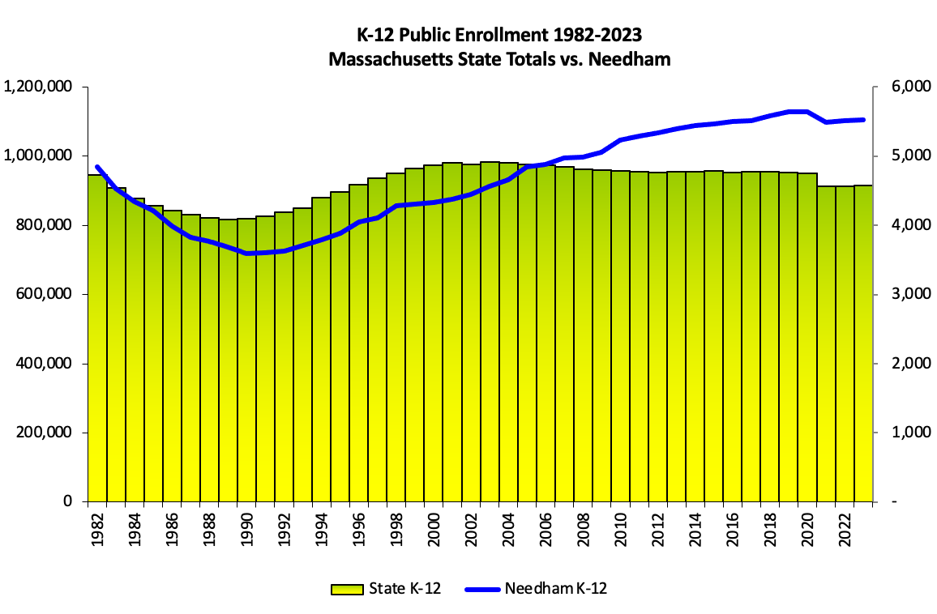
FY24 Budget Context: Enrollment
PreK-12 Enrollment projected to increase by 68 students in FY24

Slide 6
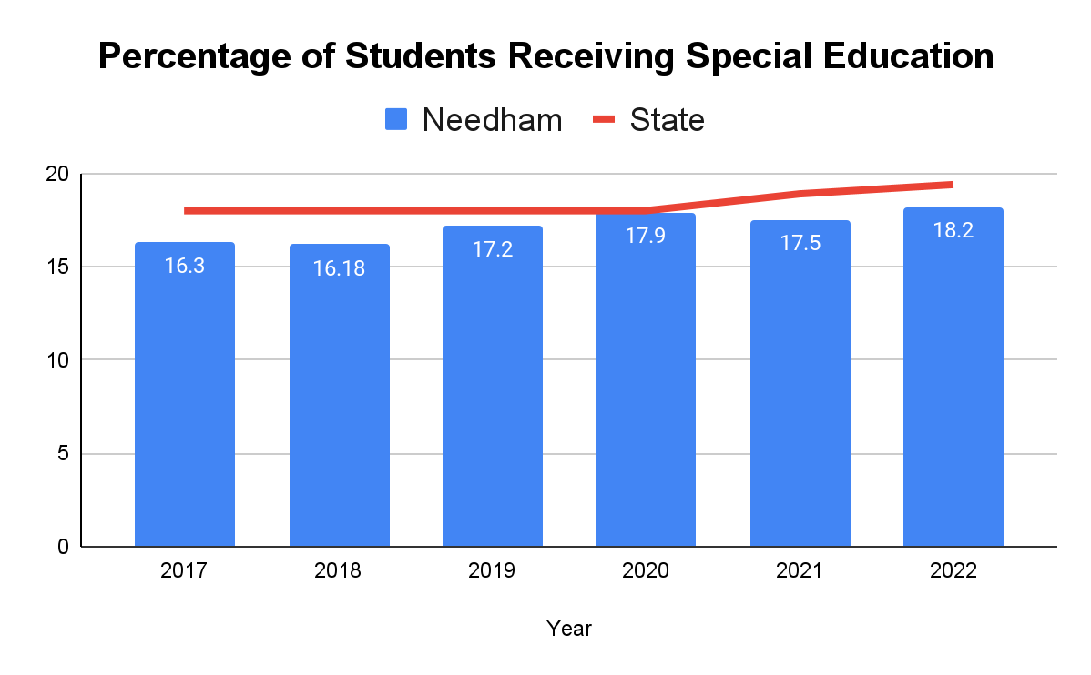
FY24 Budget Context: Special Education Enrollment

Slide 7
FY24 Operating Budget Proposed Increases
Level Service/Wages*
Program Improvements
Total proposed increase:
Plus,
Total FY24 Budget Request:
* Opens door to similar service for students, families & staff
$4.65 million $0.23 million
$4,878,175
$92,155,973
Increase over FY23: 5.59%
New Staff Requested: 14.32

Slide 8
FY24 District Staffing Requests
Kindergarten TAs for Enrollment
Student Services Teachers (SpEd, ELL, Nursing)
Student Services Paraprofessionals (SpEd)
Literacy Specialist Teachers
Special Area Teachers (FPA, Languages, Soc. Stud)
Expanded Elementary Principal (Eliot, Mitchell)
Director of Counseling Secondary Level
Total New Staffing Requests:
2.0
7.41
2.8
0.6
1.06
0.4
1.0
14.33

Slide 9
FY24 Special Education Requests
2.8 FTE
6.2 FTE
$194,962
$327,000
$83,393
Paraprofessionals (TAs, COTAs, Program Specialists, SLPAs)
Special Ed Teachers, Guidance, Psychologists, OT/PT, SLPs)
Tuition Increase
Transportation Increase
Other Professional Services
Total: $1,311,668 & 9.0 FTE

Slide 10
FY24 Proposed Increases: What will be new or expanded programming?
The Department of Elementary & Secondary recommends all K-2 students receive dyslexia screener
Addressing support services through increased ELL, nursing, special education teachers & staff; reduced special education caseloads at Mitchell
Further integrate K-5 social studies standards, anit-racist/bias curriculum, & culturally relevant literacy
Fully-funded Summer Bridges, including need-based transportation
8th grade World Language formative STAMP Assessment informs teaching practices, & student placement
A Cappella Advisor, Best Buddies Advisors, Gay/Straight Alliance advisors, & Athletic club stipends; Music/Theatre Arts staffing
Additional yellow bus service to provide additional seats
7- 12 Director of School Counseling to strengthen counseling services

Slide 11
FY24 Proposed Increases: Technology to Support Learning & Operations
Replacement digital learning devices, $62,500
Digital licenses to support elementary science curriculum, $4,500
Subscription for digital survey tool for PreK-12 use, $22,000
Increased PowerSchool service and subscription to meet program needs, $17,887
Pilot digital school dismissal management system at Broadmeadow & Eliot, $4,000

Slide 12
The FY24 Operating Budget…
Addresses priorities identified by School Committee
Builds capacity in specialized programs for special education students & counseling
Offers new summer programming
Supports sustainable & competitive wages
Redirects existing funds to meet new needs
Allows the district to continue to prioritize equity, inclusion and the Strategic Plan

Slide 13
“ Though some think we are now paying our teachers too much, we are constantly losing the services of the best of them, because they can obtain better pay elsewhere… The only alternative seems to be, either to increase the teachers’ pay a little, or to retard the present healthy progress of our students and schools…”
ggg
gg
“ The purpose of a school depends very much upon the interest taken in it by the parents. In many of our schools the parents have long since taken a deep and active interest in their children’s progress and welfare.”
“ The moral character of a school is of vital importance; mental cultivation at the expense of the cultivation of the heart, is a curse rather than a blessing. Not the more knowing & the more scientific, but rather the more virtuous the child, the man, and the people - the more happy and more useful.”
Report to the Town of Needham from the Needham School Committee April 4, 1859

